Slide 1
Computer Graphics
Unit IV Geometric transformation

Slide 2
Unit IV Geometric transformation
Contents:
2D Transformations: Introduction, Matrices, Translation, Scaling, Rotation, Homogeneous coordinates and matrix representation, rotation about an origin, rotation about an arbitrary point,
Inverse transformation, Shear transformation, Reflection
3D Transformations: Introduction, Matrices,
Rotation about an arbitrary axis,
Projections: Parallel and Perspective projection

Slide 3
Introduction of Transformations :
Computer Graphics provide the facility of viewing object from different angles. The architect can study building from different angles i.e.
Front Evaluation
Side elevation
Top plan

Slide 4
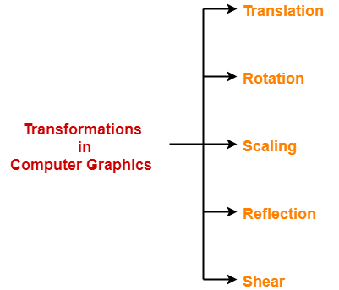

Slide 5
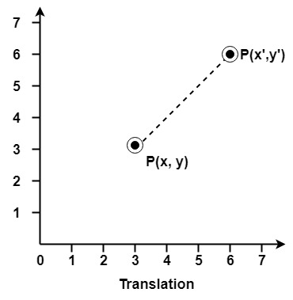
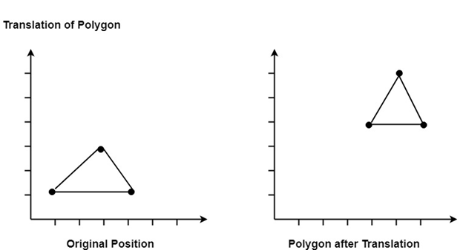
Translation :
It is the straight line movement of an object from one position to another is called Translation. Here the object is positioned from one coordinate location to another.
Translation is a movement of objects without deformation. Every position or point is translated by the same amount. When the straight line is translated, then it will be drawn using endpoints.

Slide 6
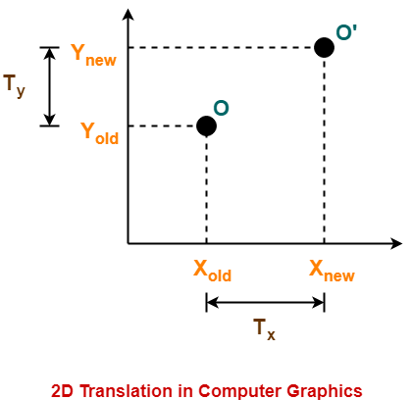

Slide 7
This translation is achieved by adding the translation coordinates to the old coordinates of the object as-
X_{new} = X_{old} + T_{x} (This denotes translation towards X axis)
Y_{new} = Y_{old} + T_{y} (This denotes translation towards Y axis)

Slide 8
2 D Translation
Repositioning along a Straight line path from one location to another are called Basic Transformations 2D translation.
That is, We translate a two-dimensional point by adding translation distances, tx and ty to the original coordinate position (x, y) to move the point to a new position (x’, y’)
Original coordinate position (x,y)
New coordinate position (x’,y’)
Translation distance pair (tx,ty)

Slide 9
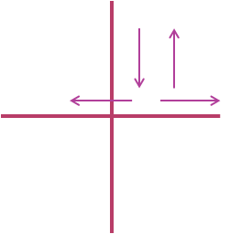
x’ = x + tx y’ = y + ty
Tx will move the object in x direction and ty will move the object in y direction. Suppose there is a point (3, 4) and we add translation vector (2, 3) then new point will be (3+2, 4+3) i.e.(5, 7).

Slide 10
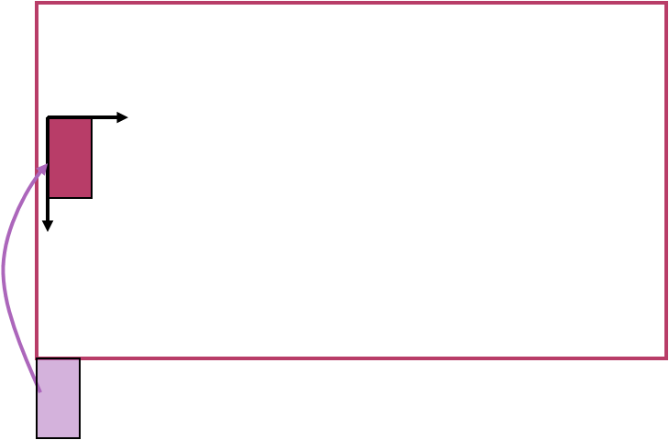
If tx is positive, object will move in right direction But If tx is negative, object will move towards left And If ty is positive object will move upwards Also if ty is negative , object will move downwards.

Slide 11
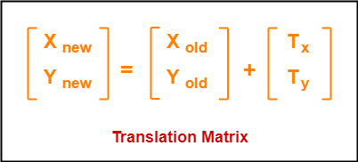
In Matrix form, the above translation equations may be represented as-

Slide 12
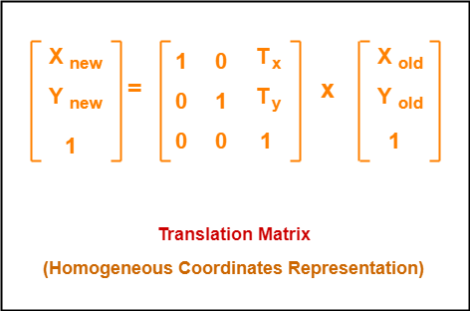

Slide 13
Basic Transformations 2D Translation is a rigid-body transformation that moves objects without deformation. To translate a t Line we translate line endpoints one by one.
However, Polygons are translated by adding the translation vector to the coordinate position of each vertex and we redraw the polygon.
To translate a circle or ellipse, we translate the center and redraw.

Slide 14
Consider an example
Translate a line AB A(4,5) , B(6,8) 2 units in x direction and 3 units in y direction.

Slide 15
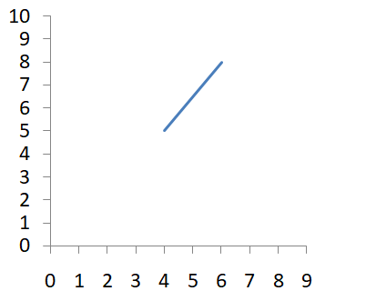
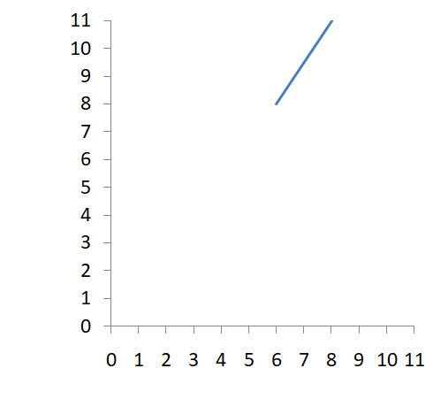
x1′ = x1+tx = 4+2 = 6 y1′ = y1+ty = 5+3 = 8 x2′ = x2+tx = 6+2 = 8 y2′ = y2+ty = 8+3 = 11
A’B’ A'(6, 8) , B'(8, 11)

Slide 16
Given a circle C with radius 10 and center coordinates (1, 4). Apply the translation with distance 5 towards X axis and 1 towards Y axis. Obtain the new coordinates of C without changing its radius.

Slide 17
Given-
Old center coordinates of C = (X_{old}, Y_{old}) = (1, 4)
Translation vector = (T_{x}, T_{y}) = (5, 1)
Let the new center coordinates of C = (X_{new}, Y_{new}).
Applying the translation equations, we have-
X_{new} = X_{old} + T_{x} = 1 + 5 = 6
Y_{new} = Y_{old} + T_{y} = 4 + 1 = 5
Thus, New center coordinates of C = (6, 5).

Slide 18
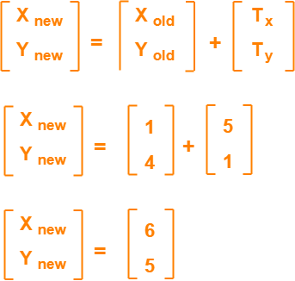
In matrix form, the new center coordinates of C after translation may be obtained as-

Slide 19
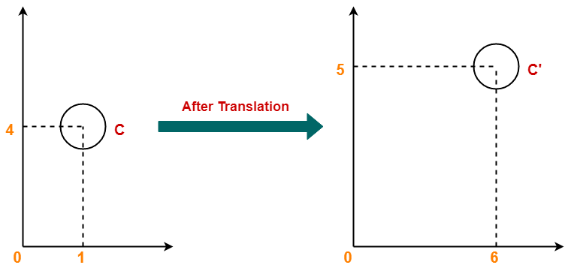
Thus, New center coordinates of C = (6, 5).

Slide 20
Given a square with coordinate points A(0, 3), B(3, 3), C(3, 0), D(0, 0). Apply the translation with distance 1 towards X axis and 1 towards Y axis. Obtain the new coordinates of the square.

Slide 21
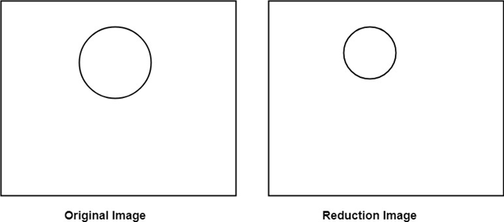
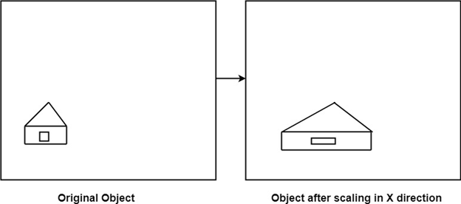
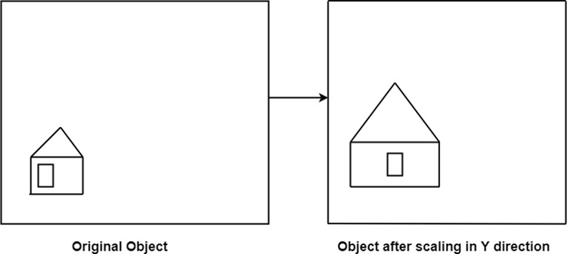
Scaling:
It is used to alter or change the size of objects. The change is done using scaling factors. There are two scaling factors, i.e. Sx in x direction Sy in y-direction. If the original position is x and y. Scaling factors are Sx and Sy then the value of coordinates after scaling will be x1 and y1.
If the picture to be enlarged to twice its original size then Sx = Sy =2. If Sxand Sy are not equal then scaling will occur but it will elongate or distort the picture.

Slide 22
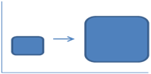
2D Scaling Transformation
2D Scaling Transformation means changing the size of an object. It is a basic geometric transformation. We can scale the object by multiplying scaling factors with coordinate points. sx is the scaling factor in the x-direction, sy is the scaling factor in the y-direction. This is 2D Scaling Transformation about the origin.

Slide 23
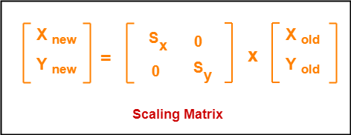
In Matrix form, the above scaling equations may be represented as-

Slide 24
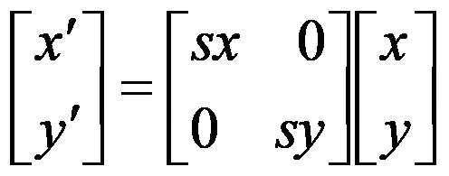
Scaling equation:
x’ = x. sx
y’ = y.sy
Scaling Matrix is a 2×2 matrix:
P’=S.P

Slide 25
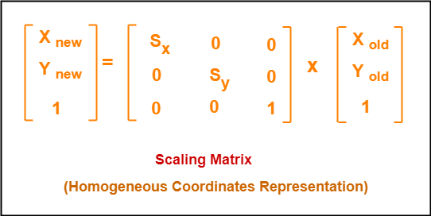
For homogeneous coordinates, the above scaling matrix may be represented as a 3 x 3 matrix as-

Slide 26

There are 2 types of scaling :
Uniform Scaling
When both the scaling factors sx, sy are same. i.e. sx=sy. In this case Size increases or reduces uniformly in both the directions. That is ratio of scaling of the object remains same in both the dimensions. for example in the following figure square remains square.

Slide 27

Differential Scaling
When both the scaling factors sx,sy are different. Scaling will not be same in both x and y direction. In the following figure increase in x direction is more as compared to y direction. Therefore square has transformed to rectangle.

Slide 28
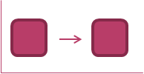
Possible values of Scaling Factors The scaling factor (sx, sy) is always positive.
Case 1: If (sx, sy) = 1
Then size of object will remain unchanged.

Slide 29

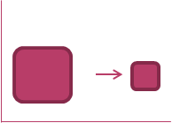
Case 2 : If (sx, sy) > 1 Then size of object will increase.
Case 2 : If (sx, sy) <1
Then size of object will decrease

Slide 30
Example
Consider a triangle ABC A(2,2) B(3,4) C(4,2) .Scale the triangle twice as large about the origin.

Slide 31
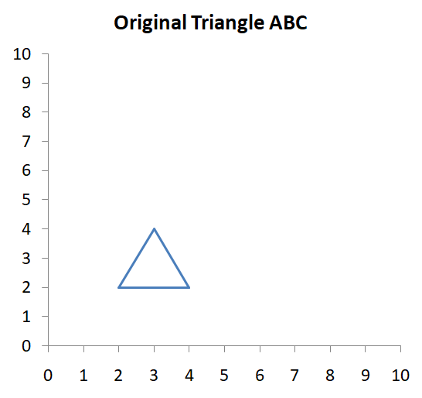
Given x1=2, y1=2 , x2=3,y2=4 , x3=4,y3=2 sx=2, sy=2

Slide 32
x1′ = x1.sx = 2 x 2 = 4
y1′ = y1.sy = 2 x 2 = 4
x2′ = x2.sx = 3 x 2 = 6
y2′ = y2.sy = 4 x 2 = 8
x3′ = x3.sx = 4 x 2 = 8
y3′ = y3.sy = 2 x 2 = 4

Slide 33
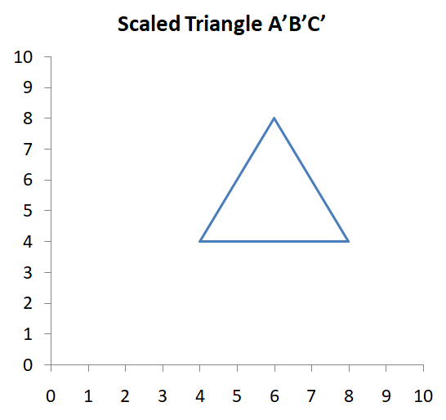
Final Triangle A’B’C’ = A'(4,4) B'(6,8) C'(8,4)

Slide 34
Given a square object with coordinate points A(0, 3), B(3, 3), C(3, 0), D(0, 0). Apply the scaling parameter 2 towards X axis and 3 towards Y axis and obtain the new coordinates of the object.

Slide 35
Solution-
Given-
Old corner coordinates of the square = A (0, 3), B(3, 3), C(3, 0), D(0, 0)
Scaling factor along X axis = 2
Scaling factor along Y axis = 3
For Coordinates A(0, 3)
Let the new coordinates of corner A after scaling = (X_{new}, Y_{new}).
Applying the scaling equations, we have-
X_{new} = X_{old} x S_{x} = 0 x 2 = 0
Y_{new} = Y_{old} x S_{y} = 3 x 3 = 9
Thus, New coordinates of corner A after scaling = (0, 9).

Slide 36
For Coordinates B(3, 3)
Let the new coordinates of corner B after scaling = (X_{new}, Y_{new}).
Applying the scaling equations, we have-
X_{new} = X_{old} x S_{x} = 3 x 2 = 6
Y_{new} = Y_{old} x S_{y} = 3 x 3 = 9
Thus, New coordinates of corner B after scaling = (6, 9).

Slide 37
For Coordinates C(3, 0)
Let the new coordinates of corner C after scaling = (X_{new}, Y_{new}).
Applying the scaling equations, we have-
X_{new} = X_{old} x S_{x} = 3 x 2 = 6
Y_{new} = Y_{old} x S_{y} = 0 x 3 = 0
Thus, New coordinates of corner C after scaling = (6, 0).

Slide 38
For Coordinates D(0, 0)
Let the new coordinates of corner D after scaling = (X_{new}, Y_{new}).
Applying the scaling equations, we have-
X_{new} = X_{old} x S_{x} = 0 x 2 = 0
Y_{new} = Y_{old} x S_{y} = 0 x 3 = 0
Thus, New coordinates of corner D after scaling = (0, 0).
Thus, New coordinates of the square after scaling = A (0, 9), B(6, 9), C(6, 0), D(0, 0).

Slide 39
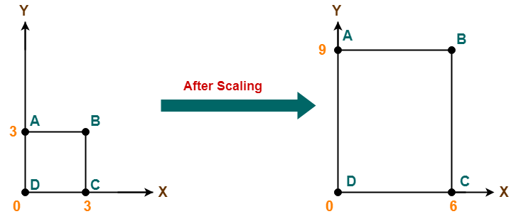

Slide 40
2D Rotation Transformation
In 2D Rotation Transformation, we change the orientation of an object. So For 2D Rotation Transformation, we require 2 things. Firstly the Pivot point about which rotation takes place. Secondly the Rotation angle.
Two types of Rotations are Possible:-
Anticlockwise Rotation
Clockwise Rotation

Slide 41
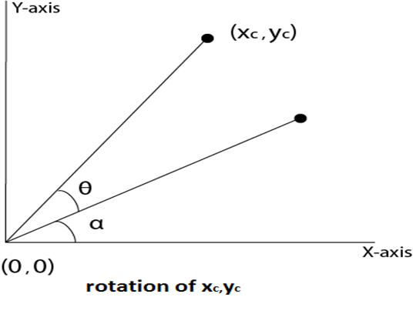
Rotation:
It is a process of changing the angle of the object. Rotation can be clockwise or anticlockwise. For rotation, we have to specify the angle of rotation and rotation point. Rotation point is also called a pivot point. It is print about which object is rotated.
Types of Rotation:
Anticlockwise
Counterclockwise
The positive value of the pivot
point (rotation angle) rotates an object in
a counter-clockwise (anti-clockwise)
direction. The negative value of the
pivot point (rotation angle) rotates an
object in a clockwise direction.

Slide 42
Consider a point object O has to be rotated from one angle to another in a 2D plane.
Let-
Initial coordinates of the object O = (X_{old}, Y_{old})
Initial angle of the object O with respect to origin = Φ
Rotation angle = θ
New coordinates of the object O after rotation = (X_{new}, Y_{new})

Slide 43
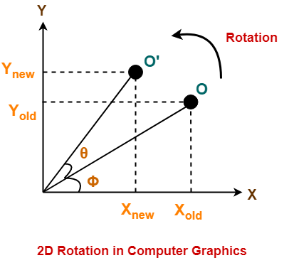

Slide 44
This rotation is achieved by using the following rotation equations-
X_{new} = X_{old} cosθ – Y_{old} sinθ
Y_{new} = X_{old} sinθ + Y_{old} cosθ

Slide 45
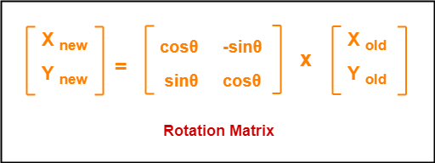
In Matrix form, the above rotation equations may be represented as-

Slide 46
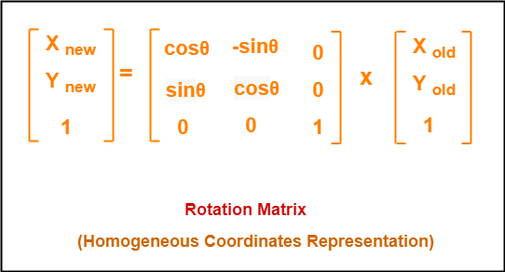
For homogeneous coordinates, the above rotation matrix may be represented as a 3 x 3 matrix as-

Slide 47
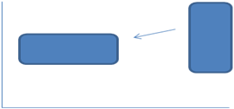
For clockwise Rotation angle is negative. While for anticlockwise Rotation angle is positive.

Slide 48
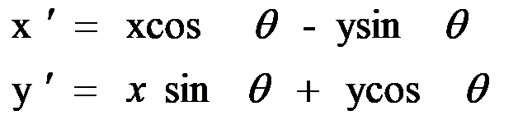
Rotation Equation
The transformation equations for rotating a point at position (x, y) through an angle theta about the origin. Then see

Slide 49
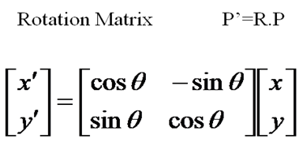
Rotation Matrix

Slide 50
Applying 2D Rotations to objects
Rotations do not change the shape of object. Every point on an object is rotated through the same angle.
If you have to rotate a line then you will apply rotation to both its end points. Then you will redraw the line with new coordinate positions. If you have to rotate a polygon then you will apply rotation to all of its vertices.
Then you will redraw the polygon with new coordinate positions.

Slide 51
Example
There is a triangle ABC A(2,2) B(3,4) C(4,2) .Then Rotate the triangle anticlockwise by angle 90º about the origin.

Slide 52
Solution: Given x1=2, y1=2 , x2=3,y2=4 , x3=4,y3=2

Slide 53
First vertex,
x1′ = x1 cos 90º – y1 sin 90º
y1′ = x1 sin 90º + y1 cos 90º
Also, We know that sin 90º = 1 and cos 90º = 0
x1′ = 2 X 0 – 2 X 1 = -2
y1′ = 2 X 1 + 2 X 0 = 2
Then, Second vertex,
x2′ = x2 cos 90º – y2 sin 90º
y2′ = x2 sin 90º + y2 cos 90º
x2′ = 3 X 0 – 4 X 1 = -4
y2′ = 3 X 1 + 4 X 0 = 3
Then, Third vertex,
x3′ = x3 cos 90º – y3 sin 90º
y3′ = x3 sin 90º + y3 cos 90º
x3′ = 4 X 0 – 2 X 1 = -2
y3′ = 4 X 1 + 2 X 0 = 4
so, Final Triangle A’B’C’ = A'(-2,2) B'(-4,3) C'(-2,4)

Slide 54
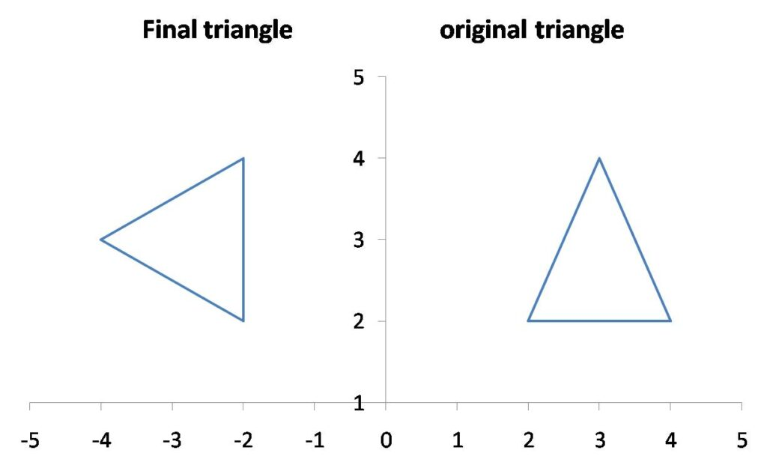

Slide 55
Given a line segment with starting point as (0, 0) and ending point as (4, 4). Apply 30 degree rotation anticlockwise direction on the line segment and find out the new coordinates of the line.

Slide 56
Solution-
We rotate a straight line by its end points with the same angle. Then, we re-draw a line between the new end points.
Given-
Old ending coordinates of the line = (X_{old}, Y_{old}) = (4, 4)
Rotation angle = θ = 30º
Let new ending coordinates of the line after rotation = (X_{new}, Y_{new}).

Slide 57
Applying the rotation equations, we have-
X_{new}
= X_{old} x cosθ – Y_{old} x sinθ
= 4 x cos30º – 4 x sin30º
= 4 x (√3 / 2) – 4 x (1 / 2)
= 2√3 – 2
= 2(√3 – 1)
= 2(1.73 – 1)
= 1.46

Slide 58
Y_{new}
= X_{old} x sinθ + Y_{old} x cosθ
= 4 x sin30º + 4 x cos30º
= 4 x (1 / 2) + 4 x (√3 / 2)
= 2 + 2√3
= 2(1 + √3)
= 2(1 + 1.73)
= 5.46
Thus, New ending coordinates of the line after rotation = (1.46, 5.46).

Slide 59
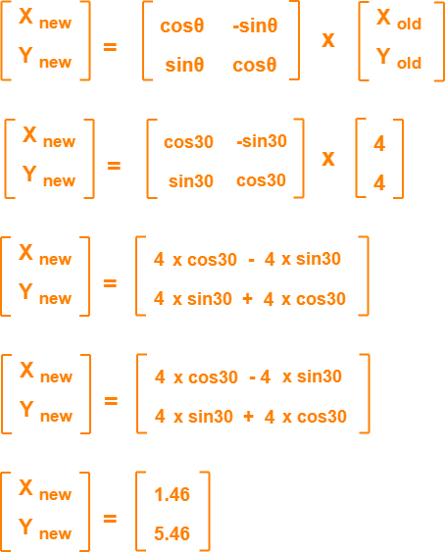
Alternatively, In matrix form, the new ending coordinates of the line after rotation may be obtained as-

Slide 60
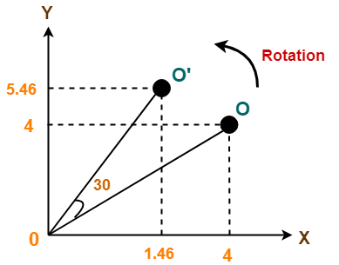
Thus, New ending coordinates of the line after rotation = (1.46, 5.46).

Slide 61
Given a triangle with corner coordinates (0, 0), (1, 0) and (1, 1). Rotate the triangle by 90 degree anticlockwise direction and find out the new coordinates.

Slide 62
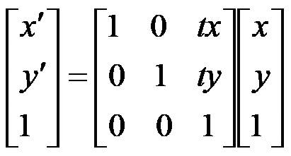
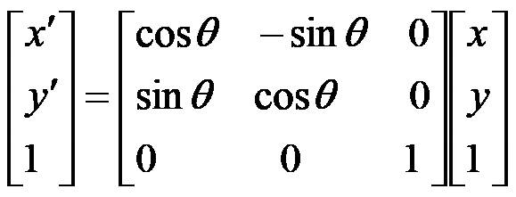
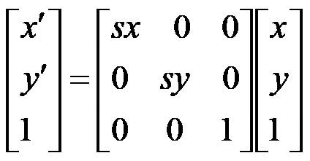
Homogeneous Coordinates

Slide 63
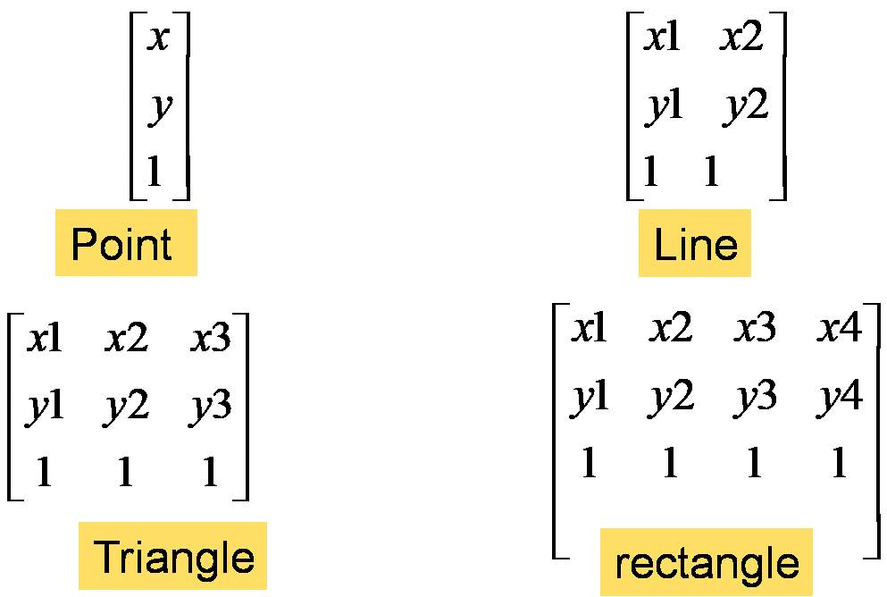
Object Matrix Representation

Slide 64
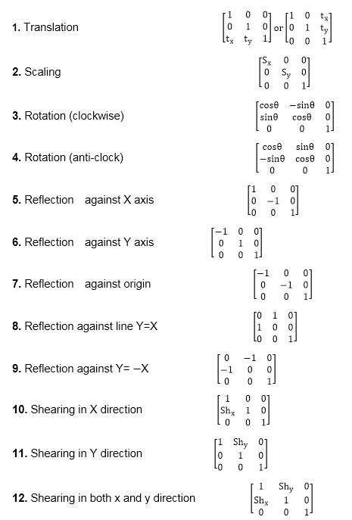
Homogeneous Coordinates :
The rotation of a point, straight line, or an entire image on the screen, about
a point other than origin is achieved by
first moving the image until the point
of rotation occupies the origin, then
performing rotation, then finally moving
the image to its original position.
To combine these three
transformations into a single transformation,
homogeneous coordinates are used.
In homogeneous coordinate system,
two-dimensional coordinate positions (x, y)
are represented by triple coordinates.

Slide 65
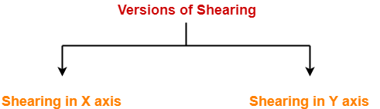

Slide 66
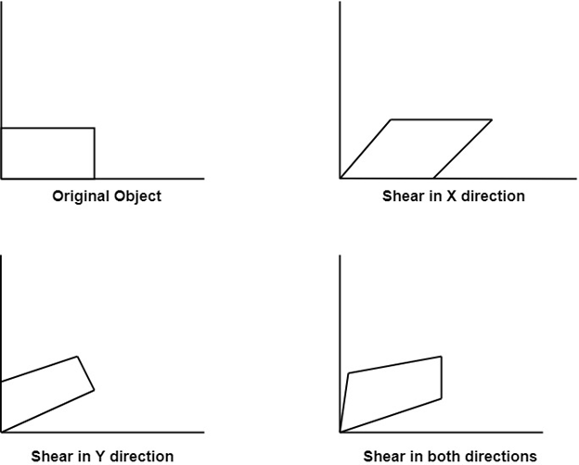
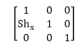
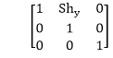
Shearing:
It is transformation which changes the shape of object. The sliding of layers of object occur. The shear can be in one direction or in two directions.
Shearing in the X-direction: In this horizontal shearing sliding of layers occur. The homogeneous matrix for shearing in the x-direction is shown below. & Shearing in the Y-direction: Here shearing is done by sliding along vertical or y-axis.

Slide 67
For Shear Transformation we need three parameters.
Direction of Shear
The magnitude of Shear or Force of Shear.
Axis of Shear

Slide 68
X-Axis Shear
X-axis Shear is given by:
x’ = x + shx . y
y’= y

Slide 69
Y-axis Shear
We can perform Shear Transformation with respect to y-axis. x coordinate value remains unaffected.
x’ = x
y’ = y + shy . x

Slide 70
Shearing in X direction
Shearing in Y direction
Consider a point object O has to be sheared in a 2D plane.
Let-
Initial coordinates of the object O = (X_{old}, Y_{old})
= Shearing parameter towards X direction Sh_{x}
Shearing parameter towards Y direction = Sh_{y}
New coordinates of the object O after shearing = (X_{new}, Y_{new})

Slide 71
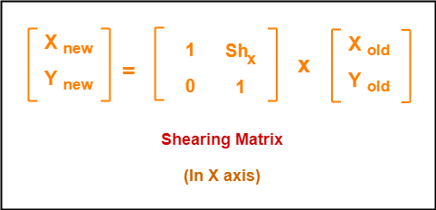
Shearing in X Axis-
Shearing in X axis is achieved by using the following shearing equations-
X_{new} = X_{old} + Sh_{x} x Y_{old}
Y_{new} = Y_{old}
In Matrix form, the above shearing equations may be represented as-

Slide 72
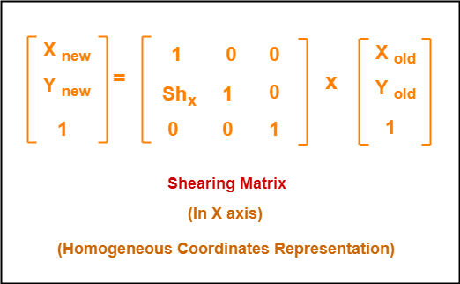
For homogeneous coordinates, the above shearing matrix may be represented as a 3 x 3 matrix as-

Slide 73
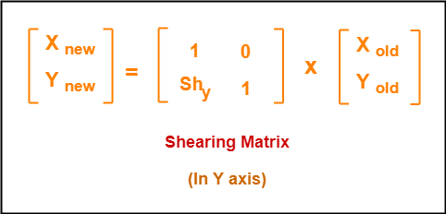
Shearing in Y Axis-
Shearing in Y axis is achieved by using the following shearing equations-
X_{new} = X_{old}
Y_{new} = Y_{old} + Sh_{y} x X_{old}
In Matrix form, the above shearing equations may be represented as-

Slide 74
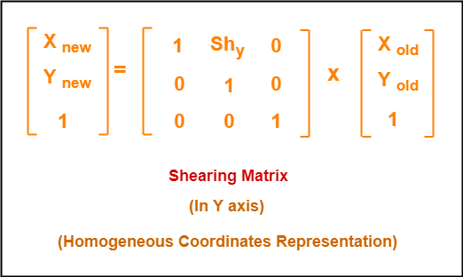
For homogeneous coordinates, the above shearing matrix may be represented as a 3 x 3 matrix as-

Slide 75
Given a triangle with points (1, 1), (0, 0) and (1, 0). Apply shear parameter 2 on X axis and 2 on Y axis and find out the new coordinates of the object.
Solution-
Given-
Old corner coordinates of the triangle = A (1, 1), B(0, 0), C(1, 0)
Shearing parameter towards X direction (Sh_{x}) = 2
Shearing parameter towards Y direction (Sh_{y}) = 2

Slide 76
Shearing in X Axis-
For Coordinates A(1, 1)
Let the new coordinates of corner A after shearing = (X_{new}, Y_{new}).
Applying the shearing equations, we have-
X_{new} = X_{old} + Sh_{x} x Y_{old} = 1 + 2 x 1 = 3
Y_{new} = Y_{old} = 1
Thus, New coordinates of corner A after shearing = (3, 1).

Slide 77
For Coordinates B(0, 0)
Let the new coordinates of corner B after shearing = (X_{new}, Y_{new}).
Applying the shearing equations, we have-
X_{new} = X_{old} + Sh_{x} x Y_{old} = 0 + 2 x 0 = 0
Y_{new} = Y_{old} = 0
Thus, New coordinates of corner B after shearing = (0, 0).

Slide 78
For Coordinates C(1, 0)
Let the new coordinates of corner C after shearing = (X_{new}, Y_{new}).
Applying the shearing equations, we have-
X_{new} = X_{old} + Sh_{x} x Y_{old} = 1 + 2 x 0 = 1
Y_{new} = Y_{old} = 0
Thus, New coordinates of corner C after shearing = (1, 0).
Thus, New coordinates of the triangle after shearing in X axis = A (3, 1), B(0, 0), C(1, 0).

Slide 79
Shearing in Y Axis-
For Coordinates A(1, 1)
Let the new coordinates of corner A after shearing = (X_{new}, Y_{new}).
Applying the shearing equations, we have-
X_{new} = X_{old} = 1
Y_{new} = Y_{old} + Sh_{y} x X_{old} = 1 + 2 x 1 = 3
Thus, New coordinates of corner A after shearing = (1, 3).

Slide 80
For Coordinates B(0, 0)
Let the new coordinates of corner B after shearing = (X_{new}, Y_{new}).
Applying the shearing equations, we have-
X_{new} = X_{old} = 0
Y_{new} = Y_{old} + Sh_{y} x X_{old} = 0 + 2 x 0 = 0
Thus, New coordinates of corner B after shearing = (0, 0).

Slide 81
For Coordinates C(1, 0)
Let the new coordinates of corner C after shearing = (X_{new}, Y_{new}).
Applying the shearing equations, we have-
X_{new} = X_{old} = 1
Y_{new} = Y_{old} + Sh_{y} x X_{old} = 0 + 2 x 1 = 2

Slide 82
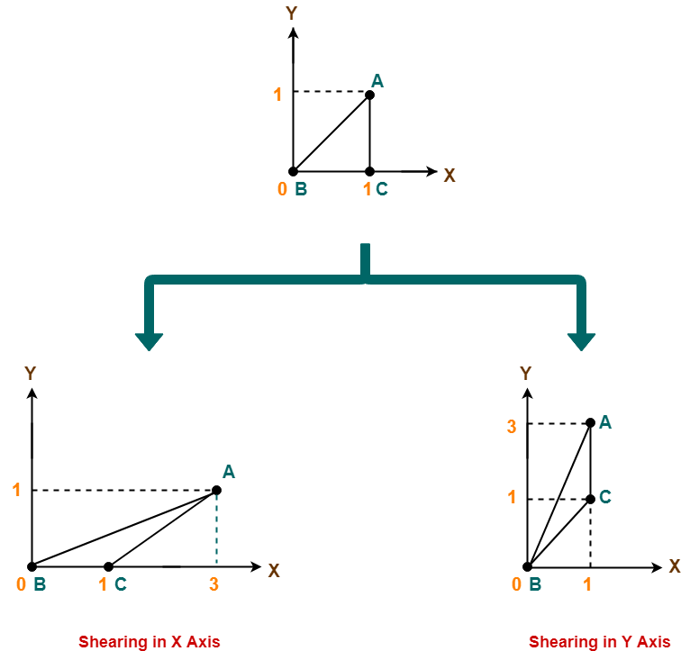
Thus, New coordinates of corner C after shearing = (1, 2). Thus, New coordinates of the triangle after shearing in Y axis = A (1, 3), B(0, 0), C(1, 2).

Slide 83
2D Reflection
Reflection is a transformation that produces a mirror image of an object. 2D Reflection is performed about a line. This line can be one of the principal axes. Or, it can be any arbitrary line. Some graphics packages contain 2D Reflection as a primitive transformation. While others may derive it from Rotation. Reflection is actually rotating an object 180 degrees about the reflection axis.

Slide 84
Types of reflection
Reflection About the line y=0 i.e. x-axis
Similarly, Reflection About the line x=0 i.e. y-axis
Also, 2D Reflection About the axis perpendicular to XY plane and which passes through the coordinate origin
Then, reflection About the line y=x
And Reflection About a line y=mx+b

Slide 85
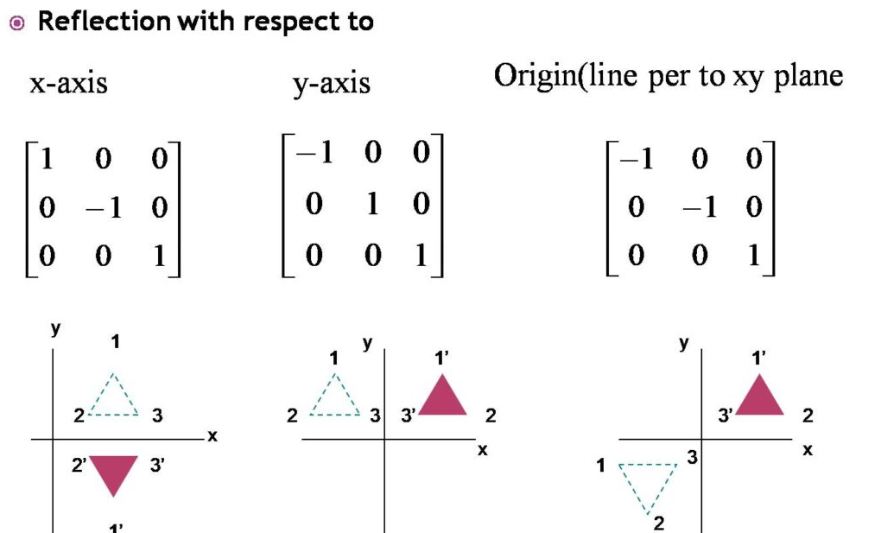

Slide 86
As you can see, When 2D Reflection is performed about the x-axis. The object will be reflected from the First quadrant to the Fourth quadrant or vice-versa. Or if the original object is in the second quadrant final object will be in the third quadrant. As if the x-axis is a mirror.

Slide 87
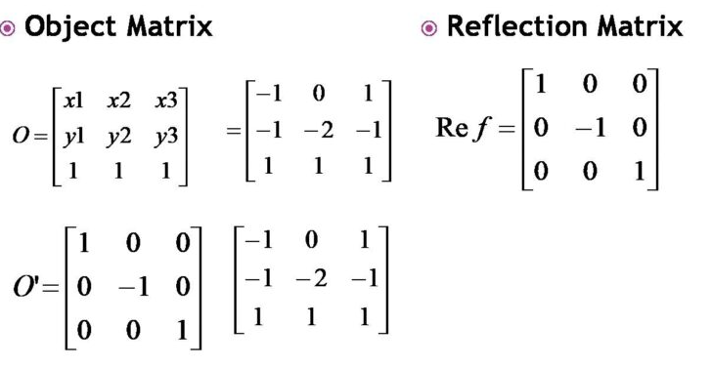

Numerical There is a triangle ABC A(-1,-1) B(0,-2)C(1,-1). Reflect the image about x axis.
Solution: First of all we will make an object matrix O with homogeneous coordinates. Then we will take the reflection matrix Ref about the x-axis. We will get the final object matrix by multiplying them.

Slide 88
You can understand 2D Reflection Transformation by this picture. Reflection does not change shape or size of an object. In the same way you can perform Reflection about the y-axis. And Reflection about the line perpendicular to XY plane.

Slide 89



Slide 90

2D Reflection with respect to a Line y=x
We know that how to perform reflection about the x-axis. So, we can derive 2D Reflection about a line y=x by a sequence of operations.
We will perform Clockwise rotation by 45 degrees. So that this line y=x coincides with the x-axis.
After that, we will simply perform Reflection about the x-axis.
Now we have to send the object back to its original position. Therefore, we will perform Counterclockwise rotation by 45 degrees.

Slide 91

This sequence of operations can be performed with the help of composite transformations.

Slide 92
2D Reflection about an arbitrary line y=mx+b
We can reflect an object about any given line. We can easily derive the Reflection matrix by performing some series of operations.

Slide 93
Sequence of operations:
Translate the line so that it passes through the origin: It is required that the line should pass through the origin. As all the axes pass through the origin. We will translate the object by the factor 0, -b. Where b is the intercept of the line. That is T(0,-b)
Clockwise rotation: Now we have to change the orientation. So that line passes through any of the axes. (We can find the angle of rotation by the relationship m=tanƟ). where m is the slope of the line. That is, R(-Ɵ)
Reflection about that axis: We will simply reflect the object about the axis using a standard 2D Reflection matrix.
Counterclockwise rotation by the same angle: R(Ɵ) We will perform this to change the orientation back as it was originally.
Translate back to original position: T(0,b). We will translate the object with the same factor but in opposite direction.

Slide 94


Slide 95
Numerical Find the reflection of a point A(5,9) about the line y=x+5

Slide 96

Solution: We have to follow the sequence of operations. Original

Slide 97

Translate the line so that it passes through the origin. T(0,-5) This is the diagonal line y=x. Reflect on the line y=x Translate the line back to original position. T(0,5)

Slide 98



Slide 99

Finally, arrange them as O’ = T(0, 5). Ref. T(0, -5). O and solve.

Slide 100



Slide 101

If we plot original and final points on the graph. We get,

Slide 102
Given a triangle with coordinate points A(3, 4), B(6, 4), C(5, 6). Apply the reflection on the Y axis and obtain the new coordinates of the object.
Given a triangle with coordinate points A(3, 4), B(6, 4), C(5, 6). Apply the reflection on the X axis and obtain the new coordinates of the object.

Slide 103

3D Geometry
Three dimension system has three axis x, y, z. The orientation of a 3D
coordinate system is of two types. Right-handed system and left-handed system.
In the right -handed system thumb of right- hand points to positive z-direction and left- hand system thumb point to negative two directions. Following figure show right-hand orientation of the cube.

Slide 104

Three Dimensional Transformations :
It is the movement of an object from one position to another position. Translation is done using translation vectors. There are three vectors in 3D instead of two. These vectors are in x, y, and z directions. Translation in the x-direction is represented using Tx. The translation is y-direction is represented using Ty. The translation in the z- direction is represented using Tz.

Slide 105
3D Translation moves the object from one place to another in a straight line direction. We need 3 translation factors for 3D Translation that is tx, ty, tz. These specify translation distances in x, y, z directions. A point is expressed as (x, y, z). These translation factors may have any value positive, zero, or negative depending on where do we want to move the object.
P’ = T. P

Slide 106


Slide 107

Let- Initial coordinates of the object O = (X_{old}, Y_{old}, Z_{old}) New coordinates of the object O after translation = (X_{new}, Y_{new}, Z_{old}) Translation vector or Shift vector = (T_{x}, T_{y}, T_{z}) Given a Translation vector (T_{x}, T_{y}, T_{z})- T_{x} defines the distance the X_{old} coordinate has to be moved. T_{y} defines the distance the Y_{old} coordinate has to be moved. T_{z} defines the distance the Z_{old} coordinate has to be moved.

Slide 108

This translation is achieved by adding the translation coordinates to the old coordinates of the object as- X_{new} = X_{old} + T_{x} (This denotes translation towards X axis) Y_{new} = Y_{old} + T_{y} (This denotes translation towards Y axis) Z_{new} = Z_{old} + T_{z} (This denotes translation towards Z axis) In Matrix form, the above translation equations may be represented as-

Slide 109
Given a 3D object with coordinate points A(0, 3, 1), B(3, 3, 2), C(3, 0, 0), D(0, 0, 0). Apply the translation with the distance 1 towards X axis, 1 towards Y axis and 2 towards Z axis and obtain the new coordinates of the object.
Solution-
Given-
Old coordinates of the object = A (0, 3, 1), B(3, 3, 2), C(3, 0, 0), D(0, 0, 0)
Translation vector = (T_{x}, T_{y}, T_{z}) = (1, 1, 2)

Slide 110
For Coordinates A(0, 3, 1)
Let the new coordinates of A = (X_{new}, Y_{new}, Z_{new}).
Applying the translation equations, we have-
X_{new} = X_{old} + T_{x} = 0 + 1 = 1
Y_{new} = Y_{old} + T_{y} = 3 + 1 = 4
Z_{new} = Z_{old} + T_{z} = 1 + 2 = 3
Thus, New coordinates of A = (1, 4, 3).

Slide 111
For Coordinates B(3, 3, 2)
Let the new coordinates of B = (X_{new}, Y_{new}, Z_{new}).
Applying the translation equations, we have-
X_{new} = X_{old} + T_{x} = 3 + 1 = 4
Y_{new} = Y_{old} + T_{y} = 3 + 1 = 4
Z_{new} = Z_{old} + T_{z} = 2 + 2 = 4
Thus, New coordinates of B = (4, 4, 4).

Slide 112
For Coordinates C(3, 0, 0)
Let the new coordinates of C = (X_{new}, Y_{new}, Z_{new}).
Applying the translation equations, we have-
X_{new} = X_{old} + T_{x} = 3 + 1 = 4
Y_{new} = Y_{old} + T_{y} = 0 + 1 = 1
Z_{new} = Z_{old} + T_{z} = 0 + 2 = 2
Thus, New coordinates of C = (4, 1, 2).

Slide 113
For Coordinates D(0, 0, 0)
Let the new coordinates of D = (X_{new}, Y_{new}, Z_{new}).
Applying the translation equations, we have-
X_{new} = X_{old} + T_{x} = 0 + 1 = 1
Y_{new} = Y_{old} + T_{y} = 0 + 1 = 1
Z_{new} = Z_{old} + T_{z} = 0 + 2 = 2
Thus, New coordinates of D = (1, 1, 2).
Thus, New coordinates of the object = A (1, 4, 3), B(4, 4, 4), C(4, 1, 2), D(1, 1, 2).

Slide 114

Scaling
Scaling is used to change the size of an object. The size can be increased or decreased. The scaling three factors are required Sx Sy and Sz.
Sx=Scaling factor in x- direction
Sy=Scaling factor in y-direction
Sz=Scaling factor in z-direction

Slide 115
3D Scaling
We can increase or reduce the size of an object with the help of 3D Scaling. There are 3 scaling factors sx, sy, sz. These scaling factors can have any positive value. If the value is greater than 1 then the object will expand. While, If the value is less than 1 then the object will shrink. But If we want to preserve the relative dimensions of the object then we should perform uniform scaling. Uniform Scaling means sx=sy=sz.

Slide 116


Slide 117


Slide 118
Given a 3D object with coordinate points A(0, 3, 3), B(3, 3, 6), C(3, 0, 1), D(0, 0, 0). Apply the scaling parameter 2 towards X axis, 3 towards Y axis and 3 towards Z axis and obtain the new coordinates of the object.
Old coordinates of the object = A (0, 3, 3), B(3, 3, 6), C(3, 0, 1), D(0, 0, 0)
Scaling factor along X axis = 2
Scaling factor along Y axis = 3
Scaling factor along Z axis = 3

Slide 119
For Coordinates A(0, 3, 3)
Let the new coordinates of A after scaling = (X_{new}, Y_{new}, Z_{new}).
Applying the scaling equations, we have-
X_{new} = X_{old} x S_{x} = 0 x 2 = 0
Y_{new} = Y_{old} x S_{y} = 3 x 3 = 9
Z_{new} = Z_{old} x S_{z} = 3 x 3 = 9
Thus, New coordinates of corner A after scaling = (0, 9, 9).

Slide 120
For Coordinates B(3, 3, 6)
Let the new coordinates of B after scaling = (X_{new}, Y_{new}, Z_{new}).
Applying the scaling equations, we have-
X_{new} = X_{old} x S_{x} = 3 x 2 = 6
Y_{new} = Y_{old} x S_{y} = 3 x 3 = 9
Z_{new} = Z_{old} x S_{z} = 6 x 3 = 18
Thus, New coordinates of corner B after scaling = (6, 9, 18).

Slide 121
For Coordinates C(3, 0, 1)
Let the new coordinates of C after scaling = (X_{new}, Y_{new}, Z_{new}).
Applying the scaling equations, we have-
X_{new} = X_{old} x S_{x} = 3 x 2 = 6
Y_{new} = Y_{old} x S_{y} = 0 x 3 = 0
Z_{new} = Z_{old} x S_{z} = 1 x 3 = 3
Thus, New coordinates of corner C after scaling = (6, 0, 3).

Slide 122
For Coordinates D(0, 0, 0)
Let the new coordinates of D after scaling = (X_{new}, Y_{new}, Z_{new}).
Applying the scaling equations, we have-
X_{new} = X_{old} x S_{x} = 0 x 2 = 0
Y_{new} = Y_{old} x S_{y} = 0 x 3 = 0
Z_{new} = Z_{old} x S_{z} = 0 x 3 = 0

Slide 123


Rotation
It is moving of an object about an angle. Movement can be anticlockwise or clockwise. 3D rotation is complex as compared to the 2D rotation. For 2D we describe the angle of rotation, but for a 3D angle of rotation and axis of rotation are required. The axis can be either x or y or z.

Slide 124
3D Rotation
In 2D rotation we perform rotation about a point. It is called pivot point. While for 3D Rotation we need an axis of rotation. It may be any principal coordinate axes. However, we may perform rotation about any line. We also need an angle of rotation. We can perform rotation in clockwise or counter-clockwise rotation. For counter-clockwise rotation, angle is taken as positive. While for clockwise rotation, angle of rotation is taken as negative.

Slide 125


Slide 126




Slide 127
Given a homogeneous point (1, 2, 3). Apply rotation 90 degree towards X, Y and Z axis and find out the new coordinate points.
Solution-
Given-
Old coordinates = (X_{old}, Y_{old}, Z_{old}) = (1, 2, 3)
Rotation angle = θ = 90º

Slide 128
For X-Axis Rotation-
Let the new coordinates after rotation = (X_{new}, Y_{new}, Z_{new}).
Applying the rotation equations, we have-
X_{new} = X_{old} = 1
Y_{new} = Y_{old} x cosθ – Z_{old} x sinθ = 2 x cos90° – 3 x sin90° = 2 x 0 – 3 x 1 = -3
Z_{new} = Y_{old} x sinθ + Z_{old} x cosθ = 2 x sin90° + 3 x cos90° = 2 x 1 + 3 x 0 = 2
Thus, New coordinates after rotation = (1, -3, 2).

Slide 129
For Y-Axis Rotation-
Let the new coordinates after rotation = (X_{new}, Y_{new}, Z_{new}).
Applying the rotation equations, we have-
X_{new} = Z_{old} x sinθ + X_{old} x cosθ = 3 x sin90° + 1 x cos90° = 3 x 1 + 1 x 0 = 3
Y_{new} = Y_{old} = 2
Z_{new} = Y_{old} x cosθ – X_{old} x sinθ = 2 x cos90° – 1 x sin90° = 2 x 0 – 1 x 1 = -1
Thus, New coordinates after rotation = (3, 2, -1).

Slide 130
For Z-Axis Rotation-
Let the new coordinates after rotation = (X_{new}, Y_{new}, Z_{new}).
Applying the rotation equations, we have-
X_{new} = X_{old} x cosθ – Y_{old} x sinθ = 1 x cos90° – 2 x sin90° = 1 x 0 – 2 x 1 = -2
Y_{new} = X_{old} x sinθ + Y_{old} x cosθ = 1 x sin90° + 2 x cos90° = 1 x 1 + 2 x 0 = 1
Z_{new} = Z_{old} = 3
Thus, New coordinates after rotation = (-2, 1, 3).

Slide 131
3D Reflection
3D Reflection is also an useful 3D Transformation in Computer Graphics. We can perform 3D Reflection along with a plane.

Slide 132


Slide 133


Slide 134


Slide 135
Given a 3D triangle with coordinate points A(3, 4, 1), B(6, 4, 2), C(5, 6, 3). Apply the reflection on the XY plane and find out the new coordinates of the object.
Solution-
Given-
Old corner coordinates of the triangle = A (3, 4, 1), B(6, 4, 2), C(5, 6, 3)
Reflection has to be taken on the XY plane

Slide 136
For Coordinates A(3, 4, 1)
Let the new coordinates of corner A after reflection = (X_{new}, Y_{new}, Z_{new}).
Applying the reflection equations, we have-
X_{new} = X_{old} = 3
Y_{new} = Y_{old} = 4
Z_{new} = -Z_{old} = -1
Thus, New coordinates of corner A after reflection = (3, 4, -1).

Slide 137
For Coordinates B(6, 4, 2)
Let the new coordinates of corner B after reflection = (X_{new}, Y_{new}, Z_{new}).
Applying the reflection equations, we have-
X_{new} = X_{old} = 6
Y_{new} = Y_{old} = 4
Z_{new} = -Z_{old} = -2
Thus, New coordinates of corner B after reflection = (6, 4, -2).

Slide 138
For Coordinates C(5, 6, 3)
Let the new coordinates of corner C after reflection = (X_{new}, Y_{new}, Z_{new}).
Applying the reflection equations, we have-
X_{new} = X_{old} = 5
Y_{new} = Y_{old} = 6
Z_{new} = -Z_{old} = -3
Thus, New coordinates of corner C after reflection = (5, 6, -3).
Thus, New coordinates of the triangle after reflection = A (3, 4, -1), B(6, 4, -2), C(5, 6, -3).

Slide 139
Given a 3D triangle with coordinate points A(3, 4, 1), B(6, 4, 2), C(5, 6, 3). Apply the reflection on the XZ plane and find out the new coordinates of the object.
solution :
New coordinates of the triangle after reflection = A (3, -4, 1), B(6, -4, 2), C(5, -6, 3).

Slide 140

3D Shear We can use 3D Shear to change the shape of an object. We also use them to create general projections.

Slide 141

Shearing in X Axis-
Shearing in X axis is achieved by using the following shearing equations-
X_{new} = X_{old}
Y_{new} = Y_{old} + Sh_{y} x X_{old}
Z_{new} = Z_{old} + Sh_{z} x X_{old}

Slide 142

Shearing in Y Axis-
Shearing in Y axis is achieved by using the following shearing equations-
X_{new} = X_{old} + Sh_{x} x Y_{old}
Y_{new} = Y_{old}
Z_{new} = Z_{old} + Sh_{z} x Y_{old}
In Matrix form, the above shearing equations may be represented as-

Slide 143

Shearing in Z Axis-
Shearing in Z axis is achieved by using the following shearing equations-
X_{new} = X_{old} + Sh_{x} x Z_{old}
Y_{new} = Y_{old} + Sh_{y} x Z_{old}
Z_{new} = Z_{old}
In Matrix form, the above shearing equations may be represented as-

Slide 144
Given a 3D triangle with points (0, 0, 0), (1, 1, 2) and (1, 1, 3). Apply shear parameter 2 on X axis, 2 on Y axis and 3 on Z axis and find out the new coordinates of the object.
Solution-
Given-
Old corner coordinates of the triangle = A (0, 0, 0), B(1, 1, 2), C(1, 1, 3)
Shearing parameter towards X direction (Sh_{x}) = 2
Shearing parameter towards Y direction (Sh_{y}) = 2
Shearing parameter towards Y direction (Sh_{z}) = 3

Slide 145
Shearing in X Axis-
For Coordinates A(0, 0, 0)
Let the new coordinates of corner A after shearing = (X_{new}, Y_{new}, Z_{new}).
Applying the shearing equations, we have-
X_{new} = X_{old} = 0
Y_{new} = Y_{old} + Sh_{y} x X_{old} = 0 + 2 x 0 = 0
Z_{new} = Z_{old} + Sh_{z} x X_{old} = 0 + 3 x 0 = 0
Thus, New coordinates of corner A after shearing = (0, 0, 0).

Slide 146
For Coordinates B(1, 1, 2)
Let the new coordinates of corner B after shearing = (X_{new}, Y_{new}, Z_{new}).
Applying the shearing equations, we have-
X_{new} = X_{old} = 1
Y_{new} = Y_{old} + Sh_{y} x X_{old} = 1 + 2 x 1 = 3
Z_{new} = Z_{old} + Sh_{z} x X_{old} = 2 + 3 x 1 = 5
Thus, New coordinates of corner B after shearing = (1, 3, 5).

Slide 147
For Coordinates C(1, 1, 3)
Let the new coordinates of corner C after shearing = (X_{new}, Y_{new}, Z_{new}).
Applying the shearing equations, we have-
X_{new} = X_{old} = 1
Y_{new} = Y_{old} + Sh_{y} x X_{old} = 1 + 2 x 1 = 3
Z_{new} = Z_{old} + Sh_{z} x X_{old} = 3 + 3 x 1 = 6
Thus, New coordinates of corner C after shearing = (1, 3, 6).
Thus, New coordinates of the triangle after shearing in X axis = A (0, 0, 0), B(1, 3, 5), C(1, 3, 6).

Slide 148

Projection :
It is the process of converting a 3D object into a 2D object. It is also defined as mapping or transformation of the object in projection plane or view plane. The view plane is displayed surface.

Slide 149


Slide 150

Perspective Projection :
In perspective projection farther away object from the viewer, small it appears. This property of projection gives an idea about depth. The artist use perspective projection from drawing three-dimensional scenes.
Two main characteristics of perspective are vanishing points and perspective foreshortening. Due to foreshortening object and lengths appear smaller from the center of projection. More we increase the distance from the center of projection, smaller will be the object appear.

Slide 151


Slide 152




Slide 153




Slide 154



Slide 155


Slide 156



Slide 157


Slide 158

Parallel Projection :
Parallel Projection use to display picture in its true shape and size. When projectors are perpendicular to view plane then is called orthographic projection. The parallel projection is formed by extending parallel lines from each vertex on the object until they intersect the plane of the screen. The point of intersection is the projection of vertex.

Slide 159

Parallel Projection :
Isometric Projection: All projectors make equal angles generally angle is of 30°.
Dimetric: In these two projectors have equal angles. With respect to two principle axis.
Trimetric: The direction of projection makes unequal angle with their principle axis.
Cavalier: All lines perpendicular to the projection plane are projected with no change in length.
Cabinet: All lines perpendicular to the projection plane are projected to one half of their length. These give a realistic appearance of object.

Slide 161


Slide 162



Slide 163



Slide 164


Slide 166

ISOMETRIC PROJECTION FOR CUBE

Slide 168


Slide 169


Slide 170

.

